Slide 1
Foreign Direct Investment in
SUB SAHARAN AFRICA

Slide 2
What is Foreign Direct Investment (FDI)
Offers one source of foreign exchange inflows
In any resource constrained country, FDI can contribute towards:
Promoting technology and institutional innovation
Building human capital
Creating jobs and increasing household incomes
Promoting overall development

Slide 3
FDI is generally a positive thing
FDI Helps the country by increasing the country’s capital stocks, helping with the balance of payments.
FDI can create employment.
FDI can introduce new technology which is then adopted by locals.

Slide 4
Recap: Africa’s Economic Performance

Slide 5
GDP per capita for Sub-Saharan Africa, 1980-1999
Note: The graph shows real GDP per capita, expressed in constant 2000 US$.
Source: World Development Indicators.

Slide 6
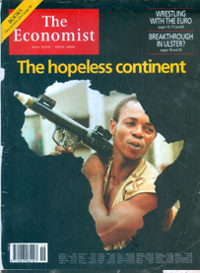
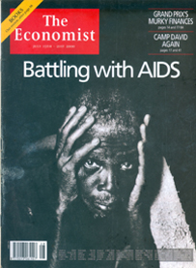
A bleak outlook at the turn of the century
May 13th, 2000
July 15th, 2000

Slide 7
GDP per capita for Sub-Saharan Africa, 2000-2009
Average growth rate: +1.8% p.a.
Note: The graph shows real GDP per capita, expressed in constant 2000 US$.
Source: World Development Indicators.

Slide 8
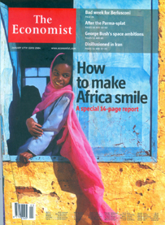
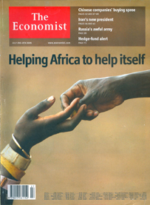
…maybe not quite hopeless?
January 17th, 2004
July 2nd, 2005

Slide 9
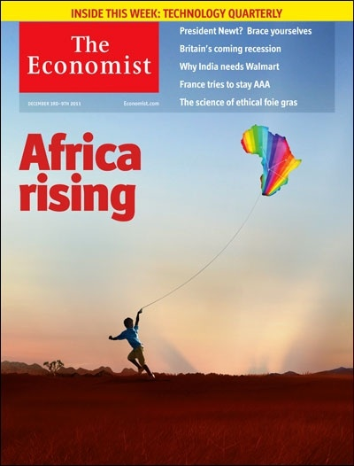
December 2011
“…at a dark time for the world economy, Africa’s progress is a reminder of the transformative promise of growth.” --The Economist, December 2011.

Slide 10
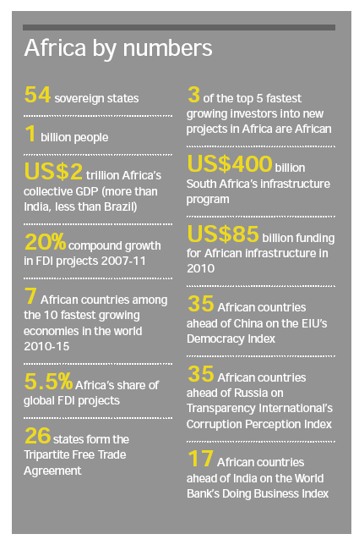

Slide 11
Closely Observing Sub-Saharan Africa’s competitiveness
Grown impressively over the past 15 years
Bounced back rapidly from the global economic crisis, when GDP regional growth dropped to 2.8 percent in 2009 back to 4.5% GDP growth , far exceeding the global average
Foreign Direct Investment Projects in Africa grew 27% from 2010 to 2011 and have grown at a compound rate of close to 20% since 2007
These developments highlight Sub Saharan Africa’s resilience to global slowdown

Slide 12
Global Competitiveness Report 2012-2013
The World Economic Forum (WEF) published its rankings of economies in terms of national competitiveness.
Of the 144 countries ranked, 38 are African economies, and South Africa, Mauritius, Rwanda and Morocco feature in the top half

Slide 13
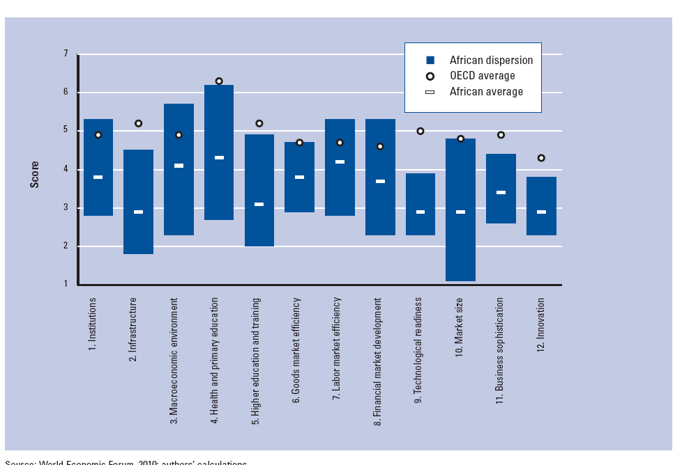

Slide 14
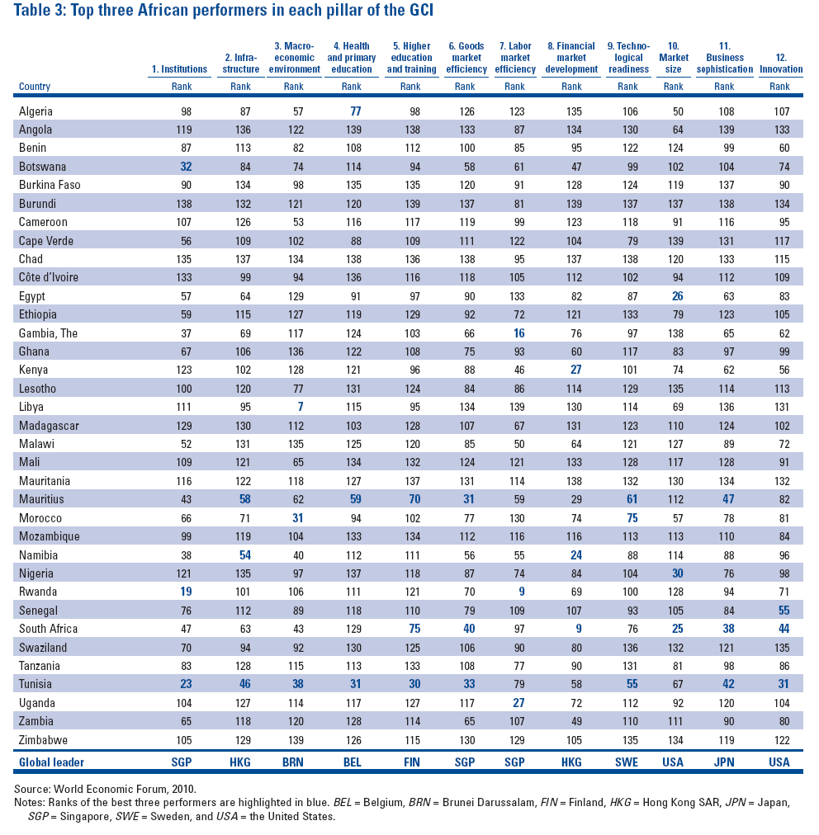

Slide 15
Country | Africa ranking | Overall ranking 2012-2013 (of 144)
South Africa | 1 | 52
Mauritius | 2 | 54
Rwanda | 3 | 63
Morocco | 4 | 70
Seychelles | 5 | 76
Botswana | 6 | 79
Namibia | 7 | 92
Gambia, The | 8 | 98
Gabon | 9 | 99
Zambia | 10 | 102
Ghana | 11 | 103
Kenya | 12 | 106
Egypt | 13 | 107
Algeria | 14 | 110
Liberia | 15 | 111
Cameroon | 16 | 112
Libya | 17 | 113
Nigeria | 18 | 115
Senegal | 19 | 117
Benin | 20 | 119

Slide 16
What is attracting FDI to Africa?
The simplest answer to the question is :
“ possibility of profitability”

Slide 17
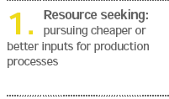
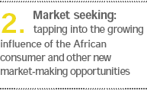
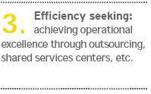
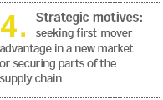
Who are the investors?

Slide 18
World Bank produces ranks emerging countries using indicator, called “the ease of doing business”.
Starting a Business
Dealing with Construction Permits
Registering a property
Getting credit
Protecting Investors
Paying taxes
Trading across borders
Enforcing contracts

Slide 19
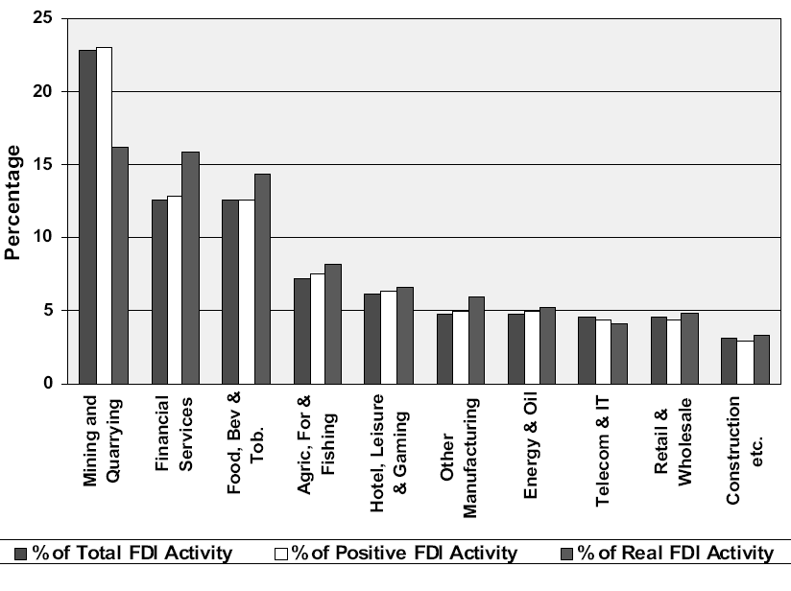
Ten Sectors attracting the highest shares of FDI activity

Slide 20
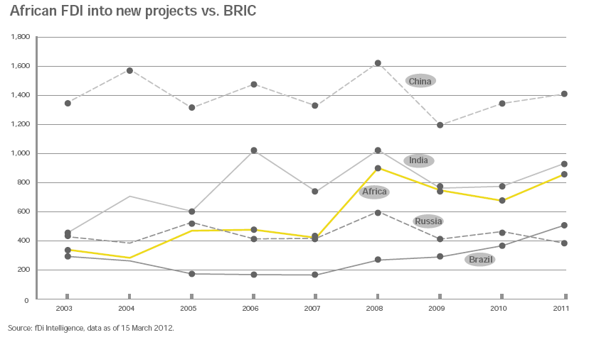

Slide 21
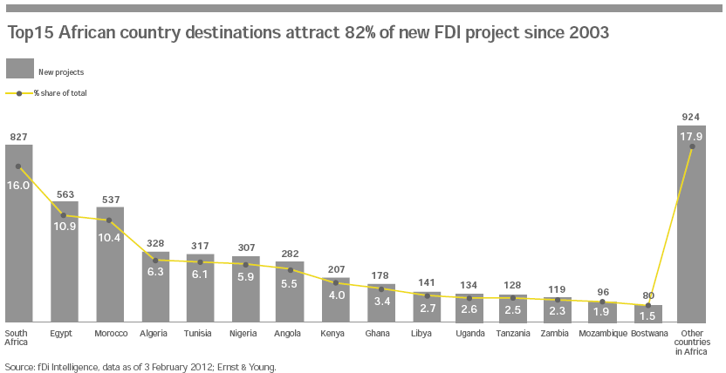

Slide 22
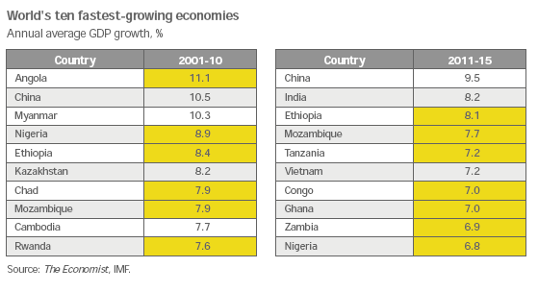

Slide 23
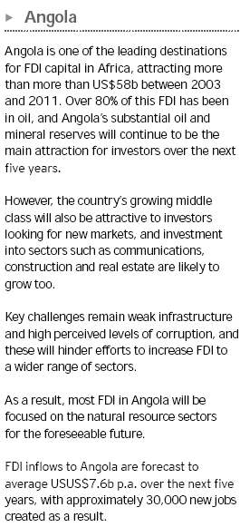

Slide 24
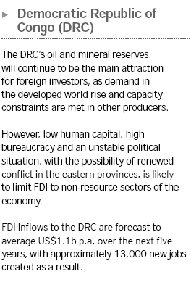

Slide 25
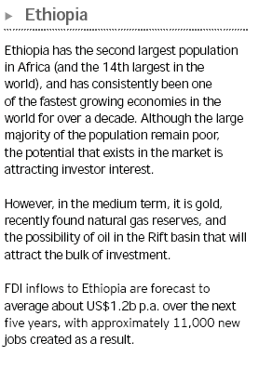

Slide 26
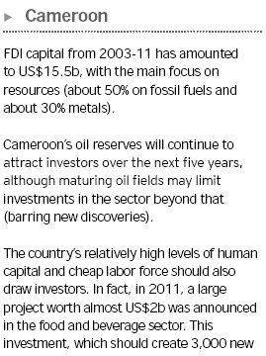
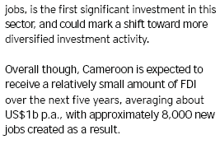

Slide 27
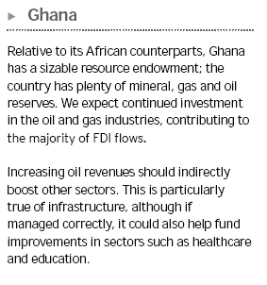
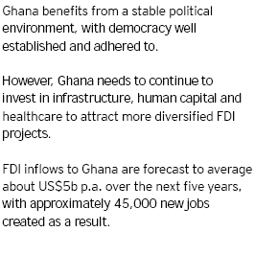

Slide 28
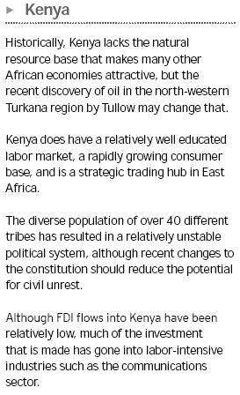
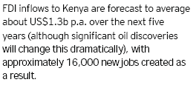

Slide 29
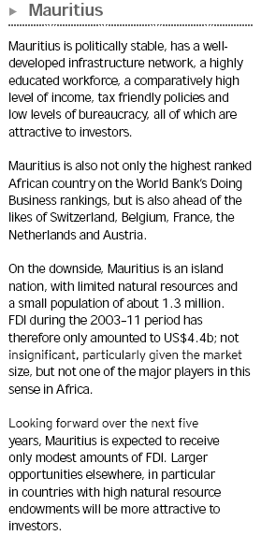
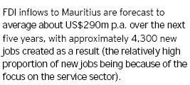

Slide 30
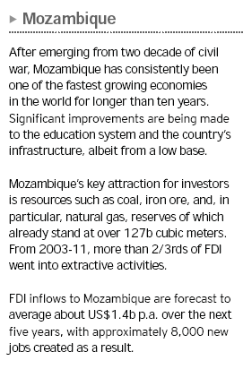

Slide 31
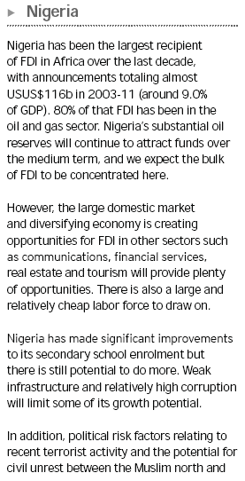
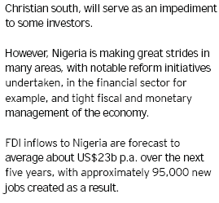

Slide 32
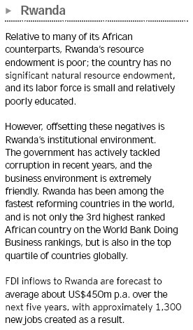

Slide 33
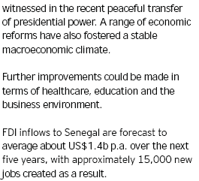
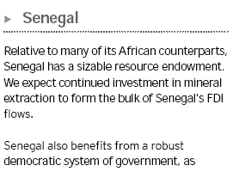

Slide 34
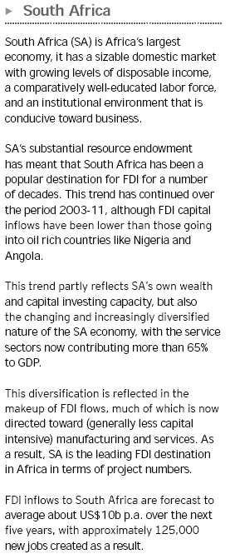

Slide 35
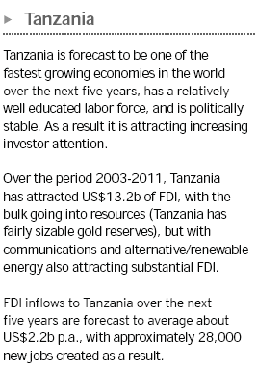

Slide 36
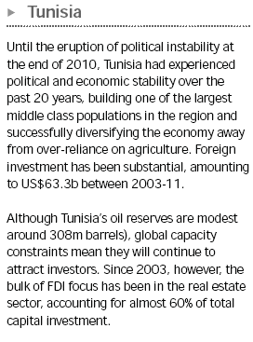

Slide 37
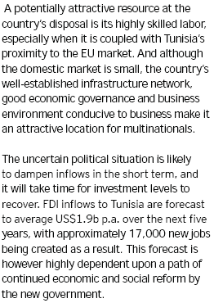

Slide 38
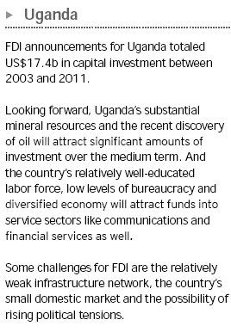


Slide 39
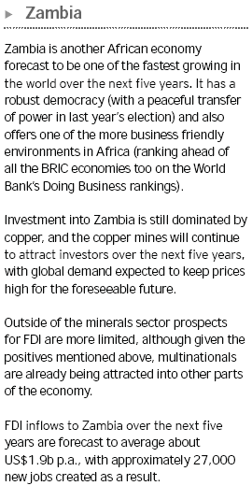

Slide 40
Caution!!
Africa's current growth largely driven by natural resources and high commodity prices
Information imperfections
Rigid labour markets
Poor access to credit
Poor Infrastructure
High Transportation cost
Lack of diversity and sophistication may pose a threat to the region's long-run growth
Many firms in SSA rely on informal, personal relationships when doing business - in response to information problems and other market failures.
Many firms in SSA have rudimentary technology and use business practices far from best practice. Low productivity
Clustering is beneficial but ignored becuase of coordination problems / – firms have weak incentives to agglomorate

Slide 41
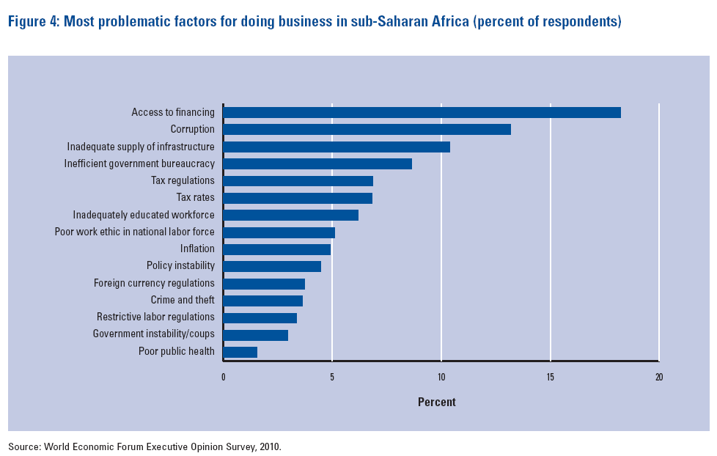

Slide 42
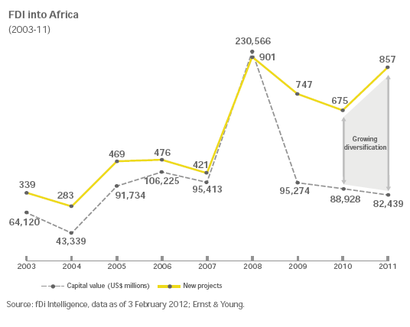

Slide 43
The Challenge: How to attract more FDI to SSA?
FDI to Africa has increased in absolute terms, but has declined relative to growth in overall flow of FDI to developing countries.
Need for enhancing investor’s confidence,
Need for good governance
Need for political alternation to bring in stability
Need for regional integration in Sub-Saharan Africa would becomes an instrument conducive to increased private investment.
Regional integration creates a larger-economic space with enlarged markets, promotes the harmonization of economic and social policies, legalization and institutionalization cooperative frameworks, and frees the mobility of goods, capital and labor, among others

Slide 44
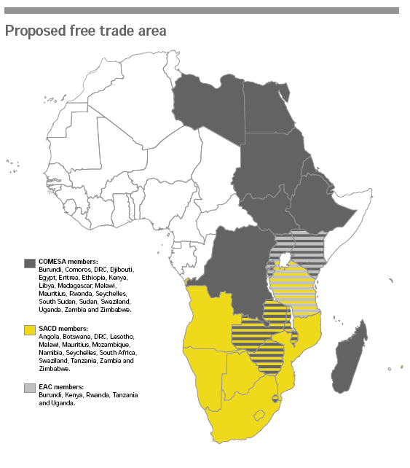
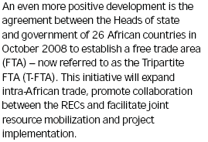
Free Intra African –Trade Agreement

Slide 45
http://nmi.is/media/92463/wef_globalcompetitivenessreport_2012-13.pdf
http://www.ey.com/Publication/vwLUAssets/EY_2012_Africa_attractiveness_survey/$FILE/attractiveness_2012_africa_v17.pdf
http://www.ustr.gov/countries-regions/africa
http://www.fas.org/sgp/crs/row/RL31772.pdf
http://www.fas.org/sgp/crs/row/RL31772.pdf
http://www.cssr.uct.ac.za/sites/cssr.uct.ac.za/files/pubs/Kaplinsky%20Morris%20EJDR%20Final%20Apr%2009.pdf

Slide 46
Current News –IMF Projection
Oil-exporting countries in SSA would experience average real GDP growth of 6.7% in 2012, and 6.0% in 2013.
Relatively stable, low-income, non-energy-producing countries (such as Ethiopia, Burkina Faso, and Kenya) are expected to grow on average by 5.9% in 2012 and 6.1% in 2013.
Middle income countries (such as South Africa) are projected to grow by 3.4% in 2012 and 3.8% in 2013.
More than half of the 12 SSA countries identified as “fragile” countries, due to prolonged institutional weakness or conflict (such as the Democratic Republic of Congo, Guinea, and Liberia), but are expected to see stronger or stable growth in 2012 (6.6%) and 2013 (5.8%).
This improved economic performance may reflect many factors, including,
Better governance, increased trade flows, strong commodity prices, rising aid flows, and debt forgiveness.
Rising incomes and expanding urban middle classes in some countries,
Economic diversification,
increased access to communications technologies

Slide 47
U.S. foreign direct investment (FDI) flows
Total world FDI to SSA amounted to about $35 billion in 2011.
Leading SSA country destinations
Nigeria ($8.9 billion),
South Africa ($5.8 billion), and
Ghana ($3.2 billion)
Other – Angola, Zambia, Kenya, Equatorial Guinea, Liberia
Total US FDI to SSA ~ $3.1 billion in 2011.
Leading SSA country destinations:
South Africa ($722 million),
Angola ($707 million),
Ghana ($250 million),
Liberia ($113 million
**(According to United Nations (UN) data,)

Slide 48
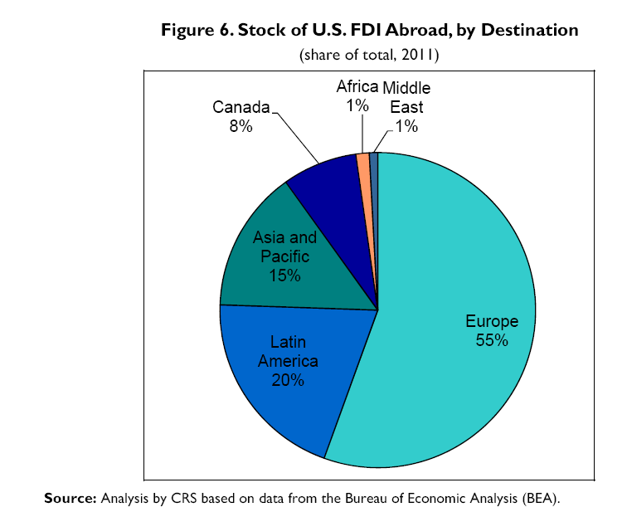
U.S. Investment in sub-Saharan Africa
SSA countries are a relatively minor destination of U.S. FDI. Africa
1% of total U.S. FDI
U.S. FDI in Africa is largely concentrated in
mining and extractive industries, which together comprise some $33 billion of the $57 billion total stock of U.S.
FDI in manufacturing industries has mostly been directed toward South Africa, which has received about 67% of total U.S. FDI in Africa’s manufacturing sector.
In terms of US FDI accumulation over time -The three countries in SSA with the largest stock of U.S. FDI are
Mauritius, South Africa, and Angola.
In terms of one-year flows for 2011, the top recipients of FDI in 2011 were
Nigeria, South Africa, and Ghana

Slide 49
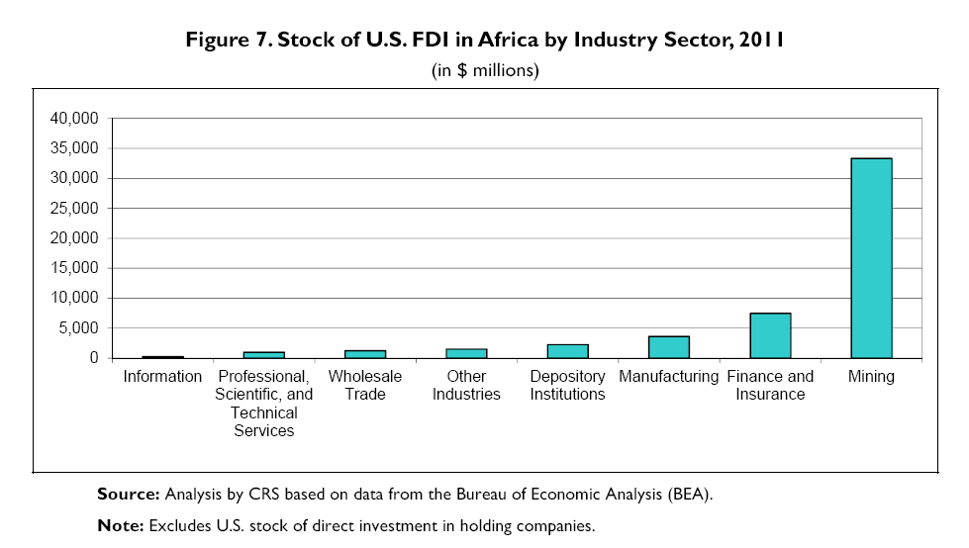

Slide 50
(1.5% of total US export) U.S.-Sub-Saharan Africa Export Trade (23 % up)
Top U.S. export markets were
South Africa ($7.2 billion; mainly machinery, vehicles and parts, gold powder, non-crude oil),
Nigeria ($4.8 billion; mainly cereals, vehicles and parts, machinery, non-crude oil),
Angola ($1.5 billion; mainly machinery, aircraft parts, poultry, iron/steel),
Ghana ($1.1 billion; mainly machinery, vehicles and parts, non-crude oil, cereals),
Ethiopia ($689 million; mainly aircraft and parts, cereals, machinery).
Top export categories were
Machinery ($4.0 billion; up 15%),
Vehicles and Parts ($3.5 billion; up 42%),
Non-Crude Oil ($1.8 billion; up 30%);
Cereals ($1.7 billion; up 31%);
Aircraft and Parts ($1.5 billion; up 32%).

Slide 51
U.S.-Sub-Saharan Africa Import Trade (14% up)
Top U.S. suppliers were
Nigeria ($33.7 billion; mainly crude oil),
Angola ($13.5 billion; mainly crude oil),
South Africa ($9.5 billion; mainly precious stones and metals, vehicles and parts, iron and steel),
Gabon ($4.5 billion; mainly crude oil),
Chad ($3.1 billion; mainly crude oil).
Top import categories were
Crude Oil ($59.8 billion; up 13%),
Precious Stones & Metals ($4.3 billion; up 9.8%),
Vehicles and Parts ($2.1 billion; up 35%),
Cocoa Products ($1.2 billion; up 22%)
Apparel ($929 million; up 14%).

Slide 52
Comparing Chinese and U.S. Trade with Africa
The value of total trade between China and Africa stood at $8.9 billion in the year 2000.
In 2009, Chinese-African trade, totaling $70.4 billion, surpassed that of U.S.-Africa trade ($62 billion), and reached $127.3 billion in 2011, an increase of 1,423% over the 2000 level.
Africa’s share of global Chinese trade also grew over the past decade, from 1.9% of Chinese global trade in 2000 to 3.5% of China’s global trade in 2011.
China is also Africa’s largest single source of imports, while the United States is its largest export destination.
In 2011, about 62% of African exports to China consisted of crude oil (over $24.77 billion of which came from Angola, the source of over 9% of China’s oil imports in 2011).
Another 34% was made up of raw materials, mostly metal commodities and wood.
Oil also dominates Africa’s exports to the United States; crude oil made up about 75% of U.S. imports from Africa in 2011.
Both China and the United States export a highly diverse, variable array of products to Africa, notably equipment, machinery, vehicles, and other technology. U.S.-African trade has also grown over the past decade, but not as rapidly as Sino-African trade.

Slide 53
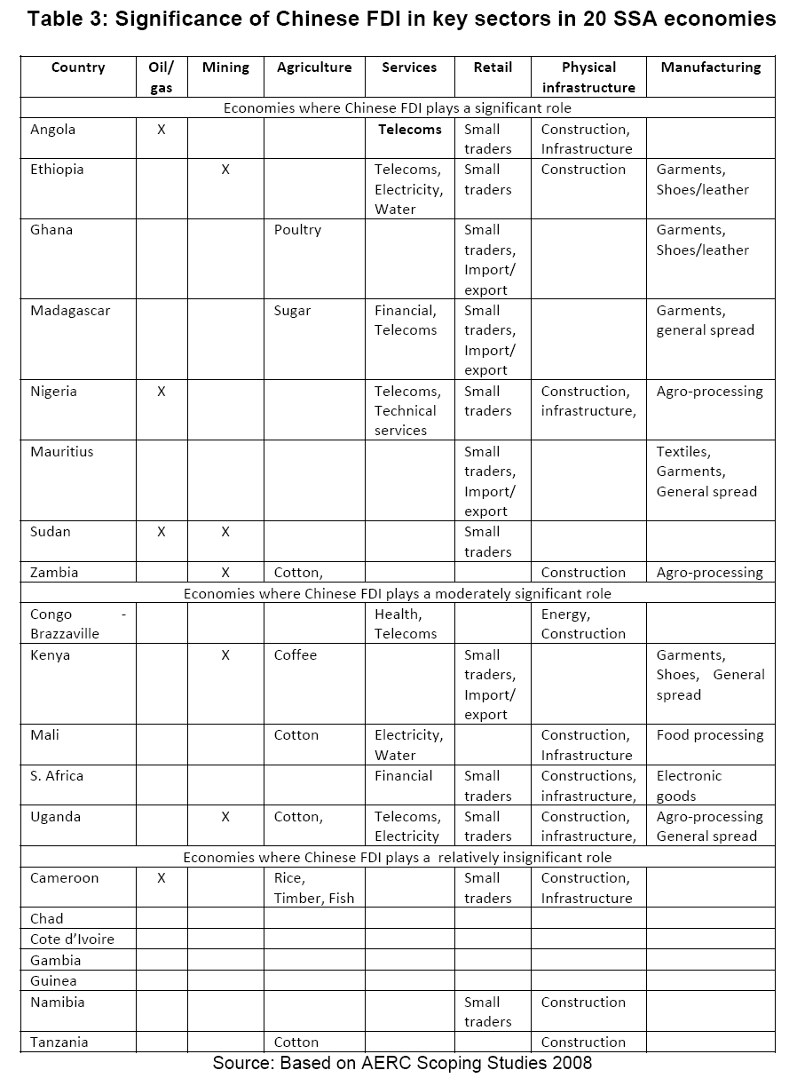
Chinese Foreign Direct Investment (FDI) into Sub-Saharan Africa (SSA)

Slide 54
Chinese FDI in comparison to US
$12 billion at present
Major Sectors other than Oil-
Agriculture – Cotton
Telecomm
Physical Infrastructure investment in construction- government buildings and sports stadiums.
FDI in manufacturing is primarily in labor intensive activities – garments dominate
Chinese FDI investment in South Africa (Banking Sector) is insignificant in comparison to its total investment in SSA

